Slide 1
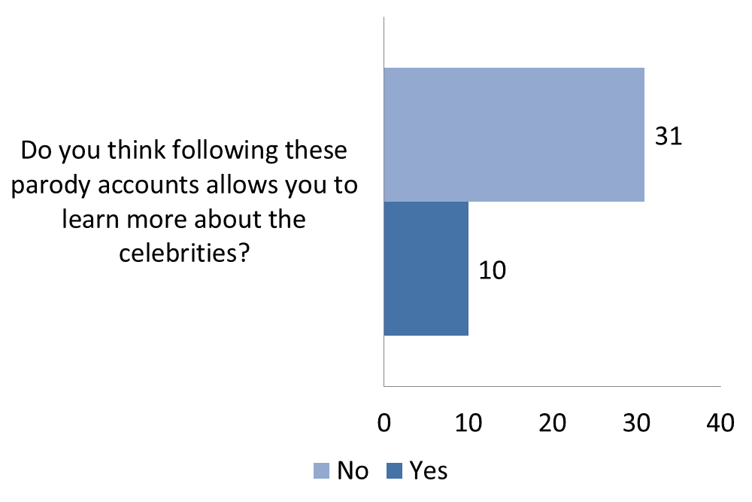
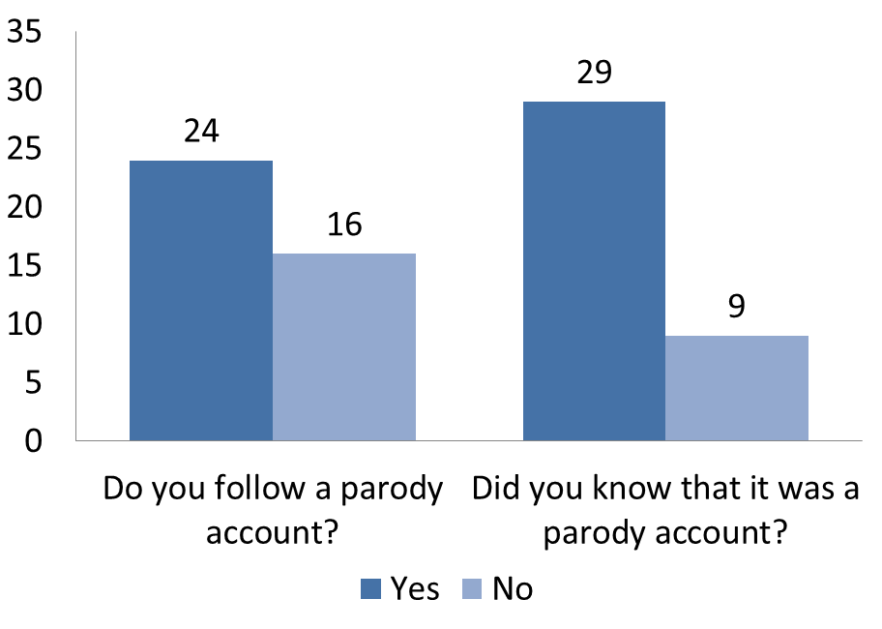
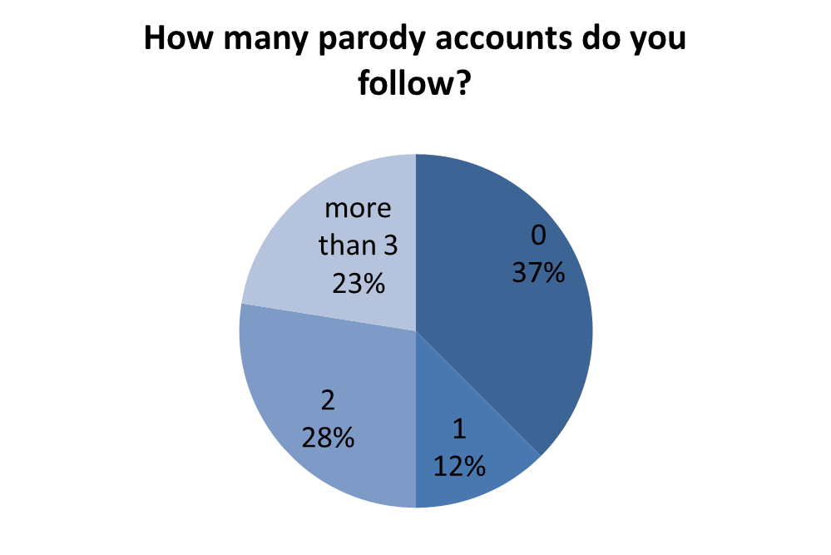
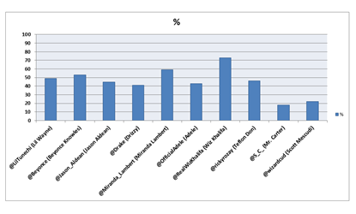
Twitter: Real or Fake?
Introduction
Group Members: Michael Kinkoph, Morgan Soladine, Josh Sefton, and Hani Dawoud
School of Informatics and Computing Indiana University Bloomington
Limitations
The main point of our research is to figure out why Twitter users create these accounts and why users follow these parody accounts. A parody account is an imitation of the style of a particular writer, artist, or genre with deliberate exaggeration for comic effect. These accounts can be made by any users on Twitter and normally are left public, opposed to a private account, so anyone can follow these accounts.
We are also interested in how these parody accounts gain so much attention from the public and have followers of 200,000 and more. Since Twitter is playing such a big role in spreading information and knowledge to the public, it’s vital to know to what extent people are consuming false information.
Question:
One problem that we experienced during our research was the data we collected through our survey. Although we sent the survey out to a lot of people, we did not receive nearly as many responses as we would have liked to represent our data. As for the data mining process, we were only able to request 5000 followers 150 times per hour. Since some twitter accounts have millions of followers this became a problem.
Our goal is to find out whether people following parody accounts know the real counterpart or not. If they know, why do they still follow that parody?
Data & Results
Conclusion
After analyzing the data between our survey and data mining we found contrasting results. The survey had a bias audience as they were mainly college students and are perhaps the most knowledgeable age group about social media. The survey found that most people knew when they were only following a parody account. If they happen to only follow a parody account and not the real account it was usually for humor. The data mining results found that most people that follow a parody account of a celebrity do not follow their real account. This backs up the results of the survey somewhat because people are very aware whether they are following a parody account or a real account. However, the percentage of people that are not aware the account is a parody could be consuming false information on a daily basis. Twitter is a key mean to spreading information and knowledge. It is vital to know to what extent people do consume false information.
Methods
For the first part of our research we created a survey on survey monkey and sent it out via Facebook, email, and oncourse. There were a total of five questions on the survey:
Do you follow a parody account on Twitter? yes or no? If yes, why?
How many Twitter parody accounts do you follow?
Did you know that you were following a parody account versus the real account? If yes, how?
Do you think that following these parody accounts allows you to learn more about the celebrities? If yes, why?
What is your main reason for following a parody account?
Nearly every single person that participated in our survey, answered that the main reason they follow parody accounts is for humor and entertainment. We received a couple of responses that said they follow the parody accounts for news and information as well. The rest of the data and results are organized into the graphs and charts below:
For the second part of our research we used Twitter API to collect data about followers of certain celebrities. We chose a random sample of 10 musical artist pairs. Each pair consists of the parody account and its real counterpart. Our overall goal was to extract from the collected data meaningful conclusions about the phenomenon of parody accounts on Twitter.
Acknowledgements
We would like to thank the students of Informatics I399 for participating in our survey to help collect data for our project. We would also like to thank our mentor, Hani Dawoud, for patiently working with us and helping us throughout the project.
The results of the dataset showed that most parody account followers do not follow the real account. The percentage’s of parody account followers that do follow the real account of the corresponding artist is displayed above.

